Slide 1
Semester 3 Case study Group 13
By: Soufiane El Atmani, Jorn Kosterman & Mihai Glodici

Slide 2

Agenda
Our idea
Our documentation
Showcasing our website
Reflection

Slide 3

Our idea
Website for students and teacher
Uploading recorded lectures/demos
In the cloud and on premises
Controlled access by user accounts
Automation with ansible/terraform

Slide 4
Our documentation
Project plan & Design document

Slide 5
Progress
Documentation v1
First draft of the website
VPN infrastructure
Ansible webserver script

Slide 6
Project plan
Problem definition
No intuitive environment to upload recordings of demos and
No organization of videos in teams
Recordings expire
Project goal
Automating the implementation of the intuitive online environment where teachers can easily upload the recordings of their lectures / demos

Slide 7
Design document
Short showcase
Network diagram

Slide 8
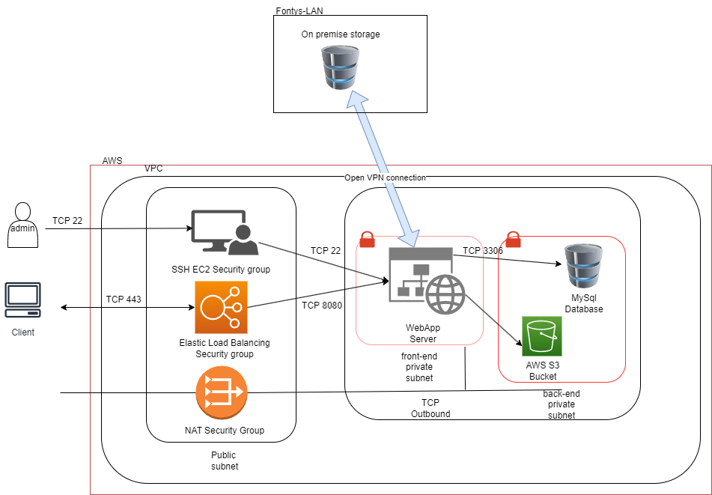
Network Diagram

Slide 9



Way of working
Daily homework & project physical meetings after class
Online Discord calls during Weekends
Discord/Teams/GitLab file sharing and synchronization

Slide 10

Showcase of our website

Slide 11
Reflections
Mihai
Soufiane
Jorn
Enjoyed Creative freedom & flexible requirements
Difficulty getting started with project idea due to cloud unfamiliarity
Confusion
Learning new stuff
Didn’t know what to do
Difficult to make plan without knowledge

Slide 12




Thank you

